Slide 1


ML/DL for Everyone with
Lecture 9:
Temrs that you hear a lot

Slide 2
Activation Functions
Yes or No. A value that decides this neuron Activates or NOT
The most famous one is Sigmoid
So many others
When we do not have the activation function the weights and bias would simply do a linear transformation
Can not solve complex problems
Gradients only exist in non-linear functions
Make backprop possible

Slide 3
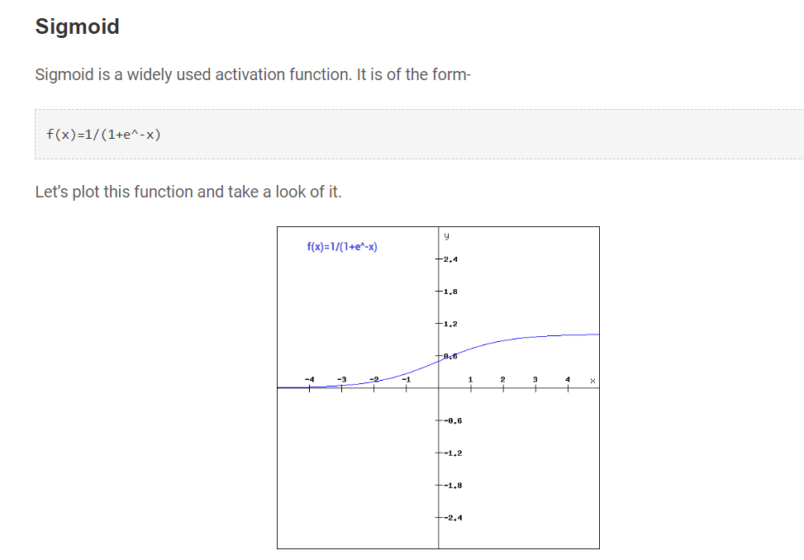

Slide 4
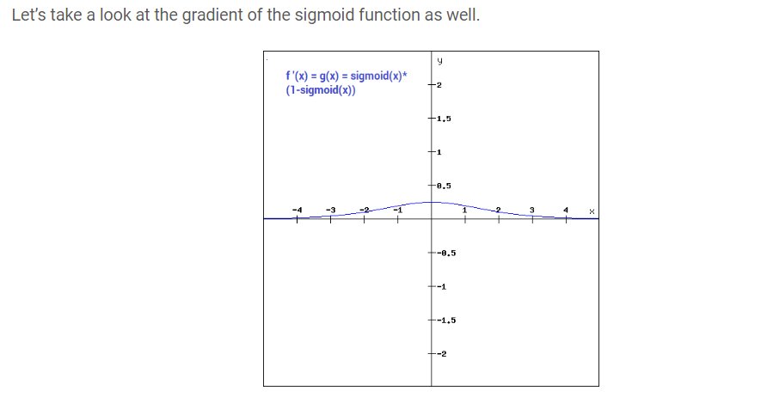

Slide 5
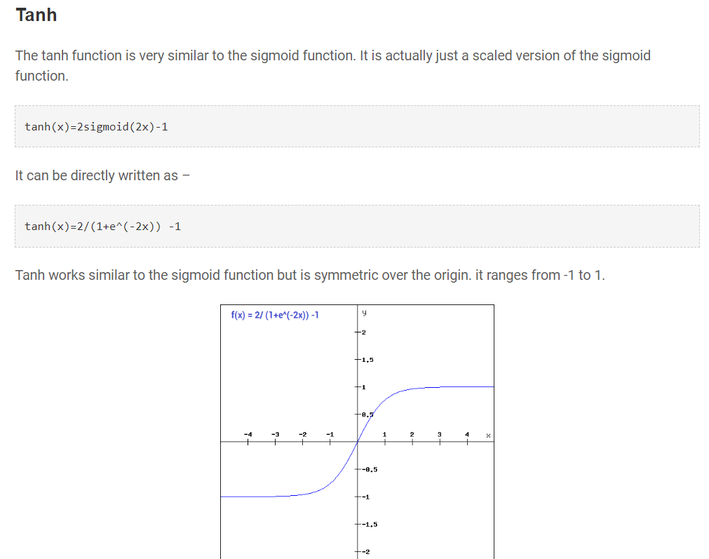

Slide 6
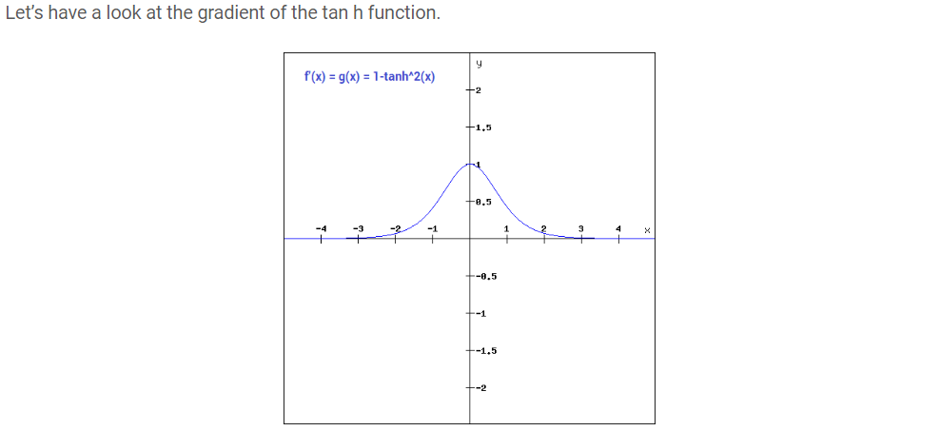

Slide 7
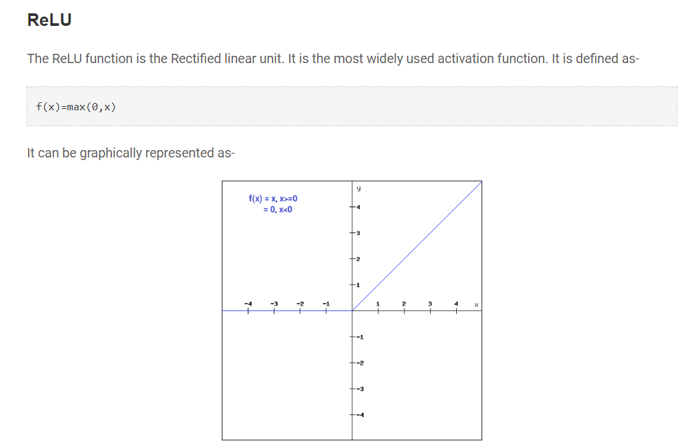

Slide 8
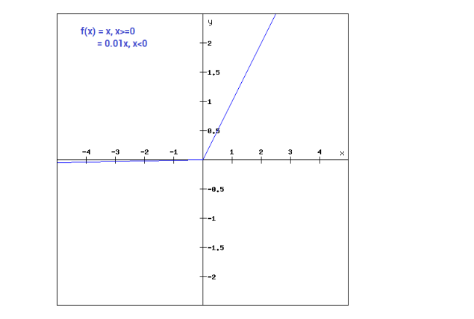

Slide 9
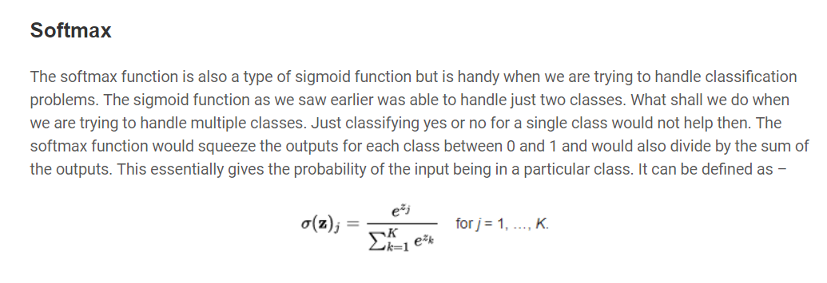

Slide 10
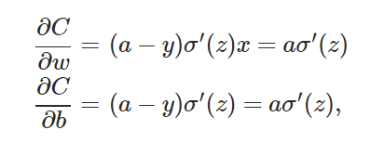
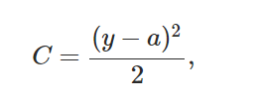
Loss Functions - MSE

Slide 11
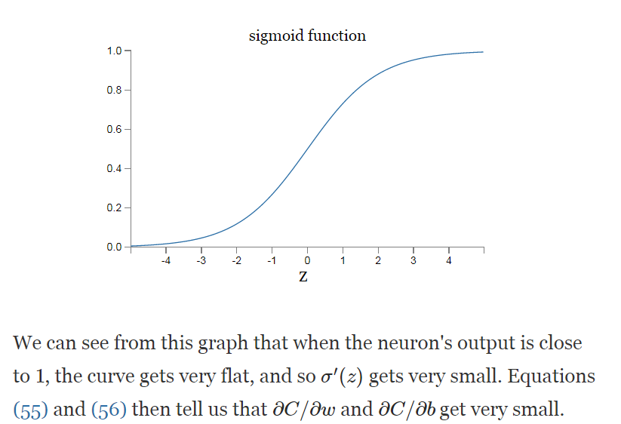

Slide 12

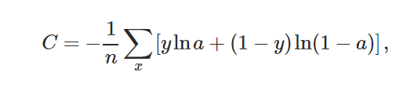
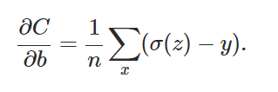
Cross-entropy
Notes:
y \in R^{N\times10}

Slide 13
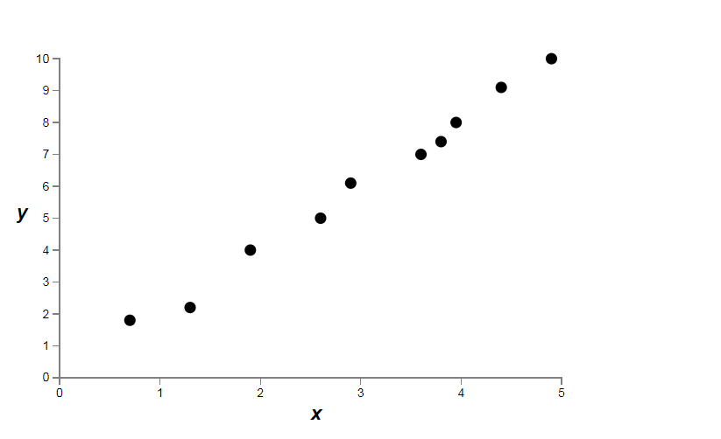
Overfitting

Slide 14
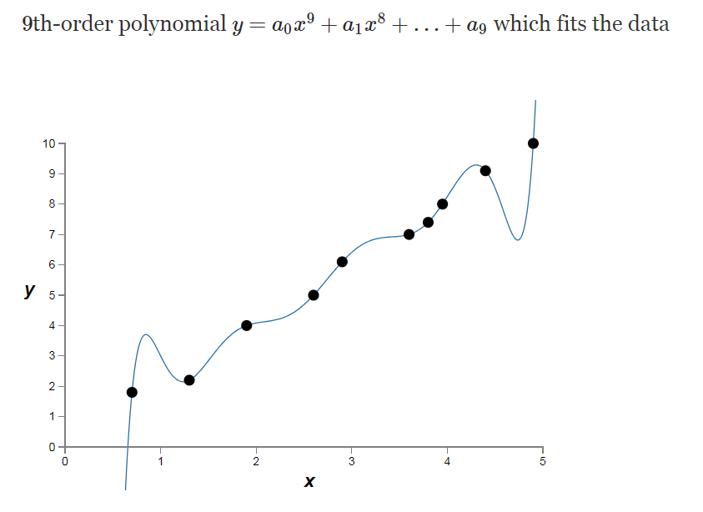
Overfitting

Slide 15
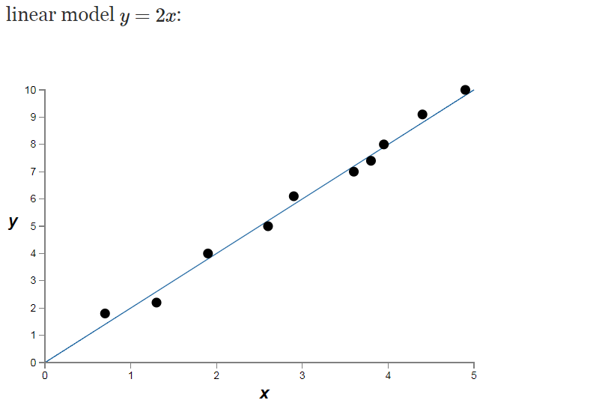
Overfitting

Slide 16
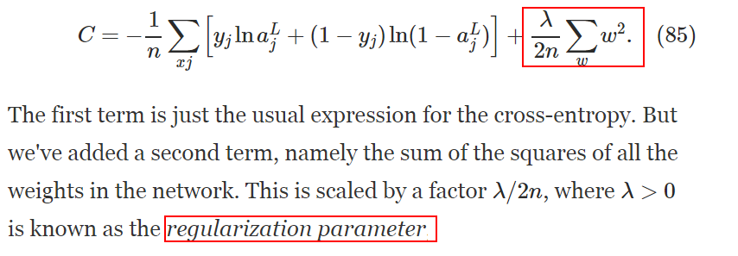
L2 Regulation
Notes:
y \in R^{N\times10}

Slide 17
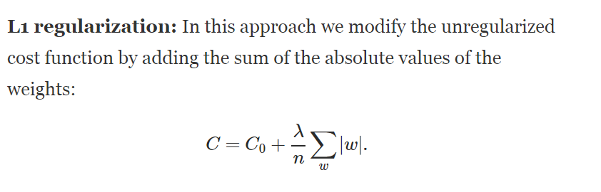
L1 Regulation
Notes:
y \in R^{N\times10}

Slide 18
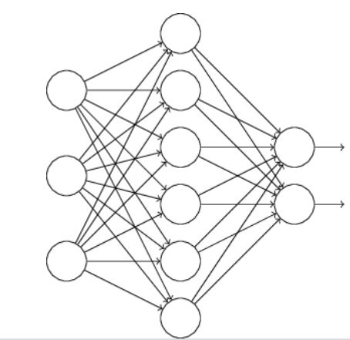
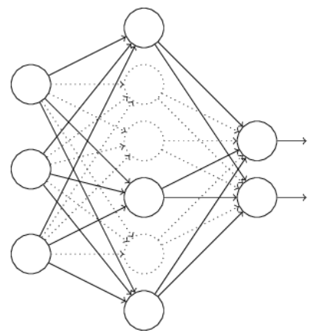
Dropout
Notes:
y \in R^{N\times10}

Slide 19
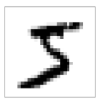
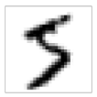
Data Augmentation(Training)
More than 100 ways !!
https://github.com/aleju/imgaug
Notes:
y \in R^{N\times10}

Slide 20
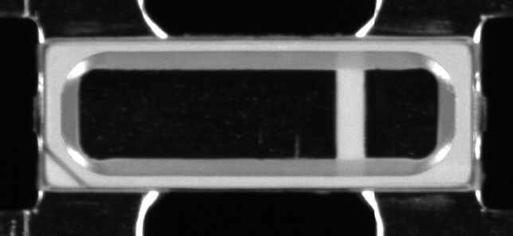
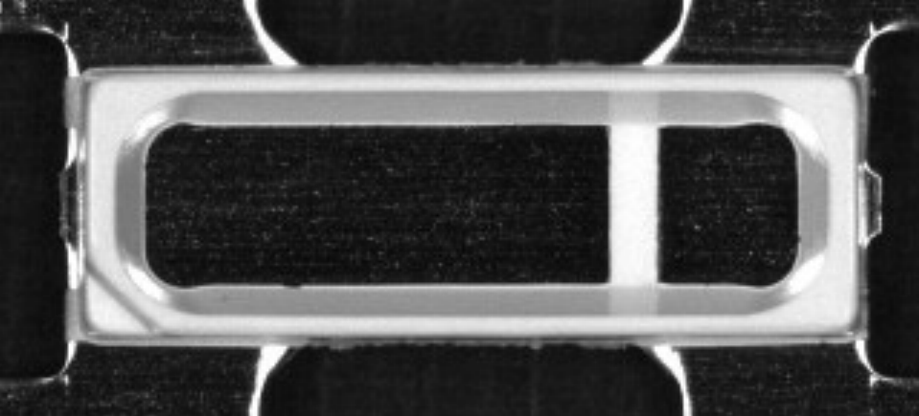
Data Augmentation(Predict)
Notes:
y \in R^{N\times10}

Slide 21
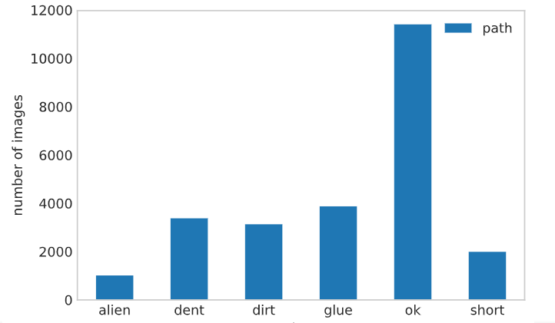
Increase Samples
Notes:
y \in R^{N\times10}

Slide 22
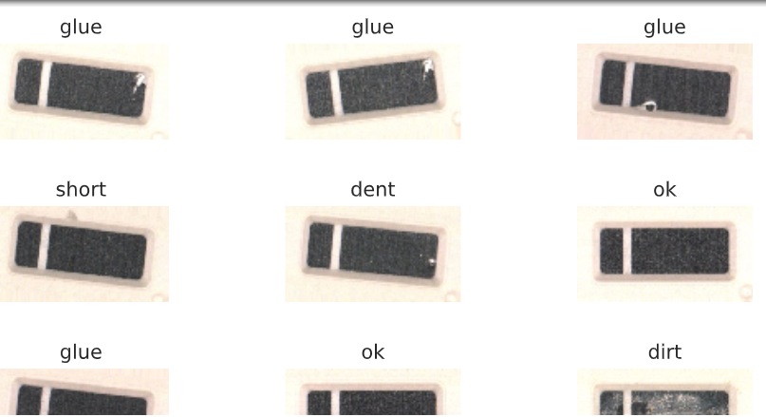
Increase Samples
Notes:
y \in R^{N\times10}

Slide 23
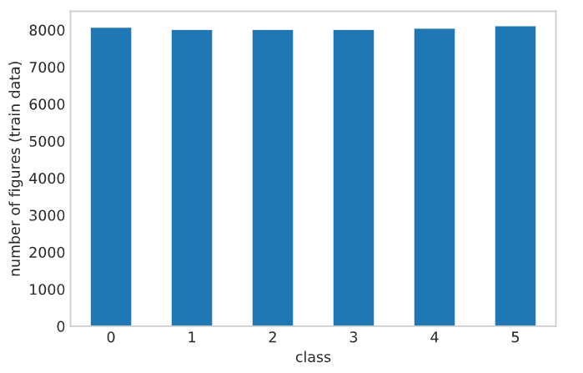
Increase Samples
Notes:
y \in R^{N\times10}

Slide 24
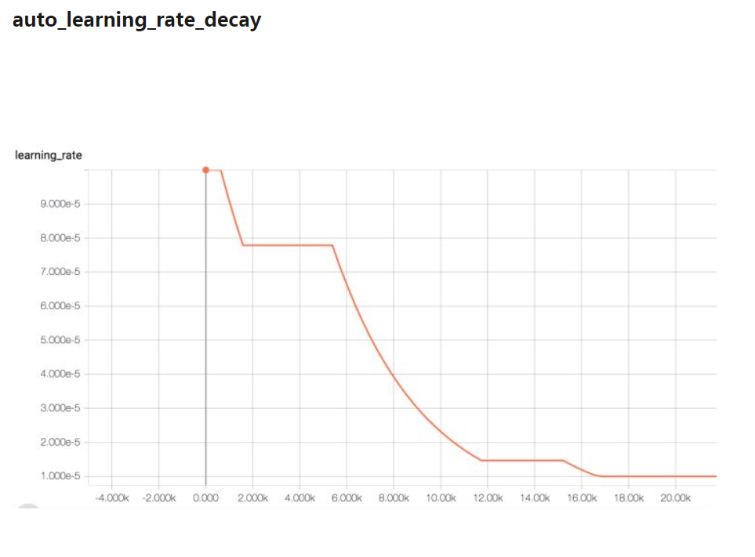
Learning Rate Decay
Notes:
y \in R^{N\times10}

Slide 25
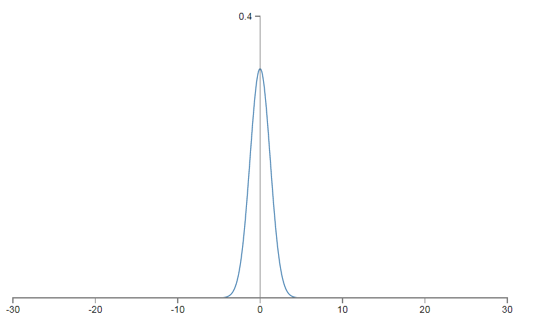
Weights/Biases Normalization
All the inputs are at a comparable range.
Two inputs varies from to 0 to 0.5 and x2 varies from 0 to 1000.
A change of x1 of 0.5 is 100 percent change where as a change of x2 by 0.5 is only a change of 0.05%
Notes:
y \in R^{N\times10}

Slide 26
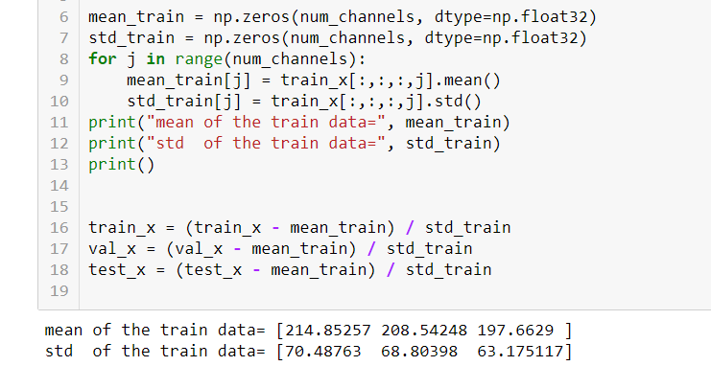
Weights/Biases Normalization
Notes:
y \in R^{N\times10}

Slide 27
Optimizers
SGD
Adam
Adadelta
Adagrad
SparseAdam
Adamax
ASGD
LBFGS
RMSprop
Rprop
Notes:
y \in R^{N\times10}

Slide 28
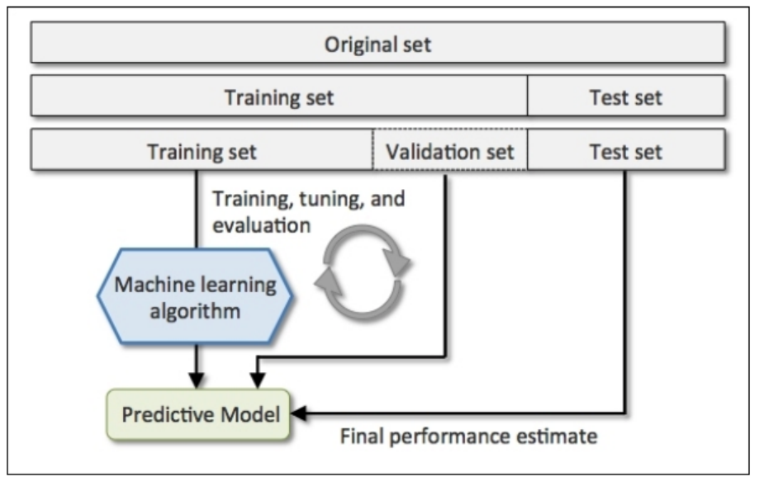
Train, Val, Test Data

